Slide 1

BACHELOR OF TECHNOLOGY
IN
Artificial Intelligence and Machine Learning
TITLE OF THE PROJECT:
Batch Names &
Department of AIML, School of Engineering
Malla Reddy University
Project Guide: Prof G. Balaiah
Batch Number: ZT16
Roll No. - Student Name:
2111CS020619 – Bramanapalli Varshith
2111CS020620 – Cheri Varshith
2111CS020625 – Gudipally Varun Reddy
2111CS020629 – Aeruva Veera Venkata Laxman
2111CS020630 – Amudalapalli Veerabhadra Sai Amarnath

Slide 2
1. INTRODUCTION
1.1 PROBLEM DEFINITION:
In today's digital world, the huge number of messages sent through emails and messaging apps contains a large amount of spam—unwanted content like ads, scams, and risky links. This causes several problems:
Full Inboxes: Spam makes it hard for users to find important messages, wasting time and lowering productivity.
Security Threats: Spam messages often have harmful links that can lead to data leaks and identity theft, making effective filtering critical.
User Frustration: Current spam filters often misclassify messages, resulting in real messages being wrongly identified as spam and spam messages getting through. This can reduce user confidence and increase exposure to risks.
To solve these issues, a stronger and more reliable spam detection system is needed.
1.2 OBJECTIVE OF PROJECT:
The goal of this project is to develop an NLP and Machine Learning system to classify messages as spam or not spam accurately. Key components include:
NLP Techniques: Using TF-IDF for feature extraction along with preprocessing steps like tokenization, lemmatization, and stop-word removal.
Machine Learning Algorithm: Applying Support Vector Machines (SVM) for effective message classification.
Enhancing User Experience: Increasing spam detection accuracy to help users focus on important messages.
This project aims to deliver a secure and efficient solution for managing digital communication.

Slide 3
1. INTRODUCTION
1.3 SCOPE & LIMITATIONS OF THE PROJECT:
Scope:
Target Platforms: Focused on classifying spam in email and mobile messaging apps, tackling a common problem in digital communication.
Integration of NLP and Machine Learning: Using natural language processing and the SVM algorithm to improve the accuracy and reliability of spam detection.
Practical Application: Can be adapted for use in existing messaging platforms to enhance their spam-filtering abilities.
Limitations:
Quality of Training Data: The accuracy of the model depends on the variety and quality of the training data. If the data is limited or not representative, it can lead to mistakes in classifying messages.
Changing Spam Patterns: Spam messages constantly change, so the model needs regular updates to recognize new types of spam effectively, which can take time and resources.
Dependence on Pre-Trained Model: The model’s performance is based on how well it was trained initially. If the training data or methods were not ideal, it may struggle to classify messages accurately in new situations.

Slide 4
2.ANALYSIS
2.1 PROJECT PLANNING AND RESEARCH
Objective:
Develop an effective spam classification system using Natural Language Processing (NLP) and machine learning to filter unwanted messages.
Project Scope:
Research: Review existing spam detection systems to identify limitations and advancements in NLP.
Development: Create a model using Support Vector Machines (SVM) with TF-IDF for feature extraction.
Testing and Evaluation: Implement thorough testing phases to assess the model's effectiveness through performance metrics.
Methodology:
Literature Review: Analyze research on spam detection.
Data Collection: Gather a dataset of spam and ham messages.
Implementation: Develop the classification model.
Evaluation: Use metrics like accuracy, precision, recall, and F1-score.
Timeline:
Weeks 1-2: Conduct literature review and finalize the dataset.
Weeks 3-4: Implement preprocessing and feature extraction.
Weeks 5-6: Train the SVM model and perform hyperparameter tuning.
Week 7: Evaluate the model's performance and refine as needed.
Week 8: Prepare documentation and deployment for the web application.

Slide 5
2.ANALYSIS
2.2 SOFTWARE AND HARDWARE REQUIREMENTS FOR SPAM CLASSIFICATION
Software Requirements:
Operating System: Windows, Linux, or macOS.
Programming Language: Python (3.6 or higher).
Libraries/Frameworks:
Flask (web development)
Scikit-learn (machine learning)
NLTK (NLP tasks)
Pandas (data manipulation)
NumPy (numerical operations)
Matplotlib/Seaborn (data visualization)
Development Environment: Google Colab and Python IDLE.
Hardware Requirements:
Processor: Dual-core (minimum); Quad-core (recommended).
RAM: 4 GB (minimum).
Storage: 10 GB free space (minimum).
Network: Reliable internet connection.
Other: Monitor (1920 x 1080 resolution), keyboard, and mouse.

Slide 6

2.ANALYSIS
2.3 MODEL SELECTION
Model Selection Criteria:
Effectiveness: How accurately the model classifies messages, how easily we can understand its decisions, and the resources required for training and predictions.
Algorithms Considered:
Naive Bayes:
Advantages: Simple to implement and fast, making it effective for large datasets.
Disadvantages: Assumes that features (words) are independent, which isn't always true.
Decision Trees:
Advantages: Easy to understand and visualize; works well with both categorical and numerical data.
Disadvantages: Can overfit the data, which means it may perform poorly on new, unseen data.
Random Forest:
Advantages: Increases accuracy by using multiple decision trees.
Disadvantages: More complicated to understand than a single decision tree, making it harder to see how it makes decisions.
Support Vector Machines (SVM):
Advantages: Effective in high-dimensional data and robust against overfitting, but requires careful tuning
of settings (hyperparameters).
Disadvantages: Needs careful tuning of settings (hyperparameters) to perform optimally.
Final Choice:
Support Vector Machines (SVM) were chosen for their high accuracy and robustness in text classification, effectively
managing high-dimensional data despite the need for careful tuning.

Slide 7
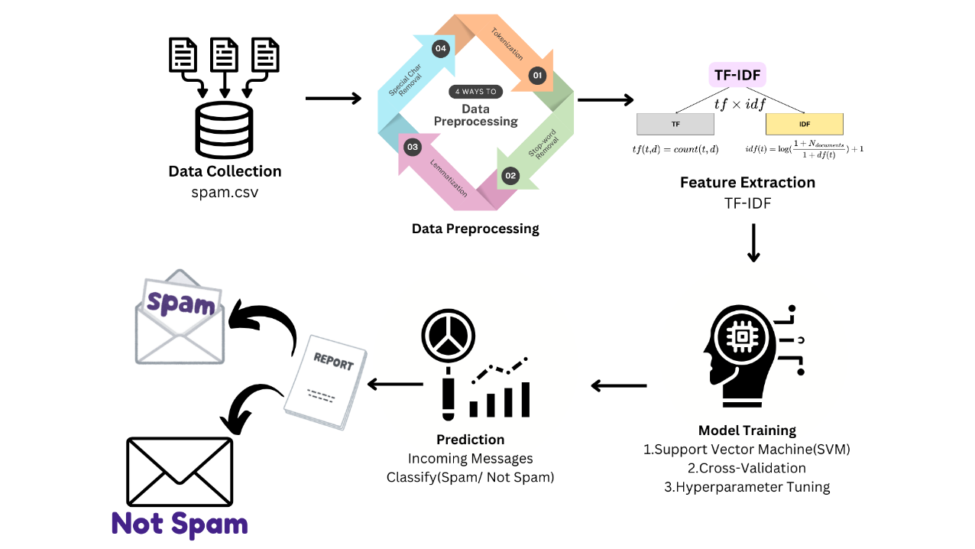
2.ANALYSIS
2.4 MODEL ARCHITECTURE
Overview of Model Architecture:
Input Layer:
Text Input: Receives raw text messages for classification.
Data Preprocessing Layer:
Tokenization: Splits text into individual tokens.
Lemmatization: Reduces tokens to their base forms.
Stop-word Removal: Eliminates common, non-significant words.
Feature Extraction Layer:
TF-IDF Vectorization: Converts text into numerical format based on Term Frequency-Inverse Document Frequency.
TF-IDF(t,d)=TF(t,d)×IDF(t)
TF(t,d)= Total number of terms in document d Number of times term t appears in document d​
IDF(t)=log (Number of documents containing term t)
(Total number of documents​)
Classification Layer:
Support Vector Machine: Classifies messages as spam or not by constructing hyperplanes in a high-dimensional space.
Output Layer:
Prediction Output: Indicates whether the message is "Spam" or "Not Spam."

Slide 8
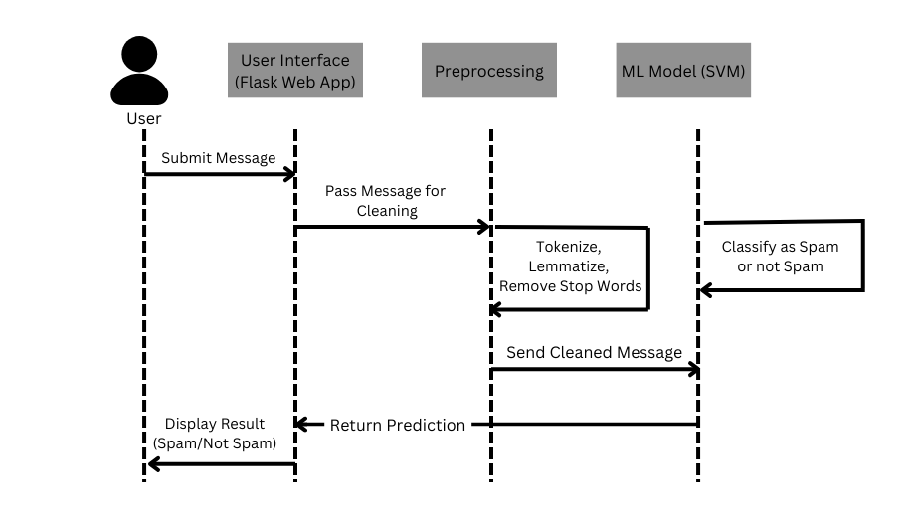
4. DESIGN
4.1 INTRODUCTION The design phase defines the structure and workflows for the spam classification system, ensuring seamless integration of components. Key elements include:
Overview of the project diagram (DFD/UML/ER).
Dataset details, including feature descriptions.
Data preprocessing techniques applied.
Description of algorithms and methods used in classification.
4.2 SEQUENCE DIAGRAM The Sequence Diagram outlines the interaction flow in the spam classification system:
User Input: User submits a message via the Flask Web App.
Message Forwarding: UI forwards the message to Preprocessing.
Preprocessing:
Tokenization: Breaks message into tokens.
Lemmatization: Reduces words to base forms.
Stop-word Removal: Eliminates common, uninformative words.
Feature Extraction: Sends cleaned message to SVM for classification.
Prediction: SVM classifies the message as spam or not.
Return Prediction: Result sent back to UI.
Display Result: UI shows classification result.

Slide 9
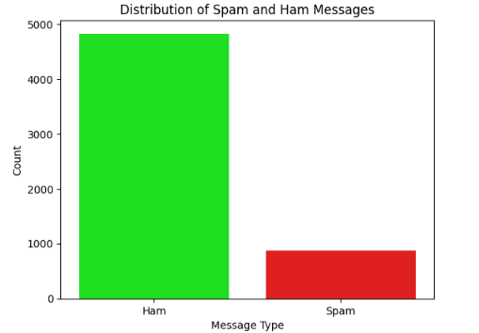
4. DESIGN
4.3 DATASET DESCRIPTION & PREPROCESSING TECHNIQUES
Dataset Details:
Total Records: 5,572
Classes: 0 (ham), 1 (spam)
Distribution: ~13.4% spam, 86.6% ham
Preprocessing Techniques:
Lowercasing: Converts text to lowercase.
Tokenization: Breaks text into tokens.
Stop-word Removal: Removes uninformative words.
Lemmatization: Simplifies word forms.
Special Character Removal: Eliminates non-alphabetic characters.
4.4 METHODS & ALGORITHMS
Methods:
Feature Extraction (TF-IDF): Converts text to numerical features, assessing word relevance across messages.
Hyperparameter Tuning (GridSearchCV): Optimizes model parameters for improved performance using cross-validation.
Algorithm:
3. Classification Algorithm (Support Vector Machine - SVM): A powerful algorithm for binary classification that separates spam and ham messages effectively.

Slide 10
5.DEPLOYMENT & RESULTS
5.1 INTRODUCTION
This section covers the deployment, evaluation, and outcomes of the spam classification system. It provides insights into the implementation, testing, and validation stages and discusses the development of a user-friendly web interface to facilitate interaction with the classification model.
5.2 SOURCE CODE
This section includes the essential source code used for the project, highlighting key aspects like:
Data Loading and Preprocessing:
import pandas as pd
import re
from nltk.corpus import stopwords
from nltk.stem import WordNetLemmatizer
dataset = pd.read_csv('spam.csv', encoding='latin-1')
dataset.columns = ['label', 'message']
dataset['label'] = dataset['label'].map({'ham': 0, 'spam': 1})
lemmatizer = WordNetLemmatizer()
stop_words = set(stopwords.words('english'))
corpus = []
for msg in dataset['message']:
msg = re.sub('[^a-zA-Z]', ' ', msg).lower()
msg = ' '.join([lemmatizer.lemmatize(word) for word in msg.split() if word not in stop_words])
corpus.append(msg)

Slide 11
5.DEPLOYMENT & RESULTS
5.2 SOURCE CODE
TF-IDF Feature Extraction:
from sklearn.feature_extraction.text import TfidfVectorizer
from sklearn.model_selection import train_test_split
tfidf = TfidfVectorizer(max_features=5000)
X, y = tfidf.fit_transform(corpus).toarray(), dataset['label'].values
x_train, x_test, y_train, y_test = train_test_split(X, y, test_size=0.2, random_state=0)
Model Training with Hyperparameter Tuning:
from sklearn.svm import SVC
from sklearn.model_selection import GridSearchCV
param_grid = {'C': [0.1, 1, 10], 'gamma': ['scale', 'auto'], 'kernel': ['linear']}
grid_search = GridSearchCV(SVC(), param_grid, cv=3, scoring='accuracy').fit(x_train, y_train)
Model Evaluation:
from sklearn.metrics import classification_report, confusion_matrix
y_pred = grid_search.predict(x_test)
print(classification_report(y_test, y_pred))
print("Confusion Matrix:\n", confusion_matrix(y_test, y_pred))

Slide 12
5.DEPLOYMENT & RESULTS
5.2 SOURCE CODE
Flask Web Application Routing:
from flask import Flask, render_template, request
import pickle
app = Flask(__name__)
classifier = pickle.load(open('final_model.pkl', 'rb'))
tfidf = pickle.load(open('final_vector.pkl', 'rb'))
def predict_message(message):
transformed = tfidf.transform([message])
return "Spam" if classifier.predict(transformed)[0] == 1 else "Not Spam“
@app.route('/')
def home():
return render_template('index.html')
@app.route('/predict', methods=['POST'])
def predict():
message = request.form['message']
result = predict_message(message)
return render_template('result.html', message=message, result=result)
if __name__ == '__main__':
app.run(debug=True)

Slide 13
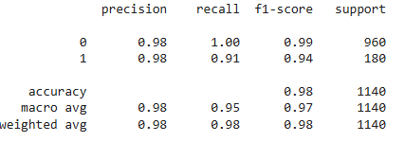
5.DEPLOYMENT & RESULTS
5.3 Model Implementation and Training
The spam classifier model is implemented using the SVM algorithm, designed to distinguish between spam and non-spam messages. This section details the training process:
Dataset Loading and Preprocessing: Preparing labeled messages and cleaning text data.
Feature Extraction with TF-IDF: Converting text into numerical data suitable for model input.
Model Training: Using the processed data to train the SVM classifier, applying parameter tuning techniques to enhance model performance.
Model Persistence: Saving the trained model and vectorizer as .pkl files to enable deployment.
5.4 Model Evaluation Metrics
Evaluation metrics assess the model’s effectiveness in identifying spam messages accurately,
including:
Accuracy: Percentage of correctly classified messages.
Precision: Proportion of actual spam messages among those classified as spam.
Recall: Ability to identify spam messages.
F1 Score: Balance of precision and recall.

Slide 14
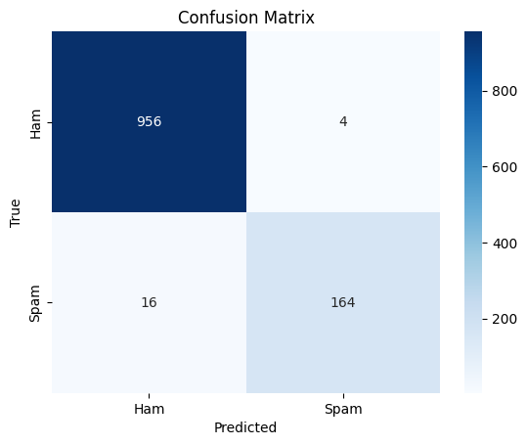
5.5 MODEL DEPLOYMENT
This section focuses on the deployment and validation of the trained model, discussing:
Testing: The model is tested on unseen messages to gauge real-world performance.
Validation: Additional evaluation ensures that the model maintains accuracy across diverse message types.
Error Analysis: Reviewing misclassified instances to identify potential areas for improvement in model accuracy.
5. DEPLOYMENT & RESULTS
5.6 RESULTS: TESTING, VALIDATION & FINAL RESULTS
Provides an analysis of the model’s performance on the test set, showcasing its ability to accurately classify spam messages.
Sample predictions showcasing the model's accuracy and reliability.
Cross-Validation Scores: Highlighting consistency across multiple data subsets, reducing overfitting risks.

Slide 15
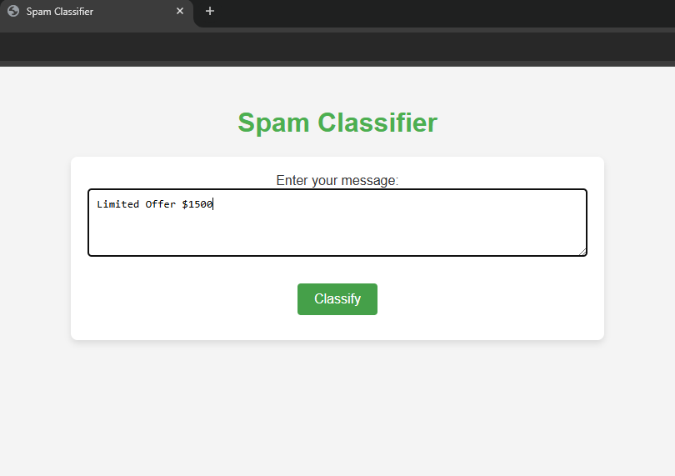
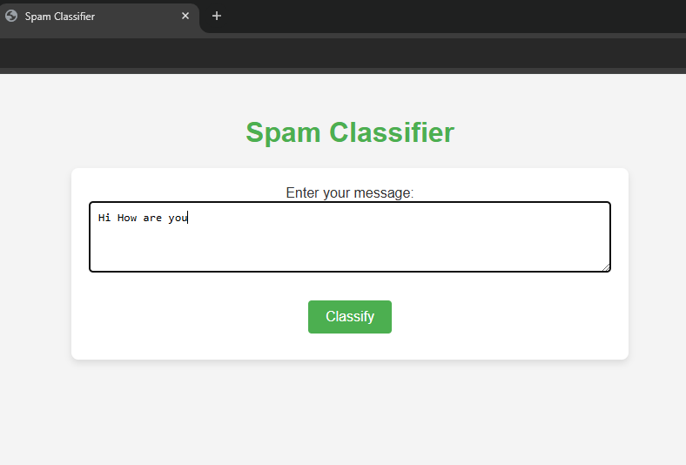
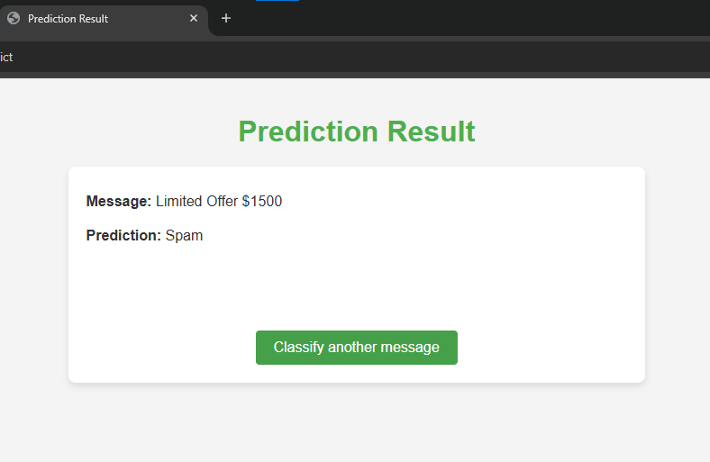
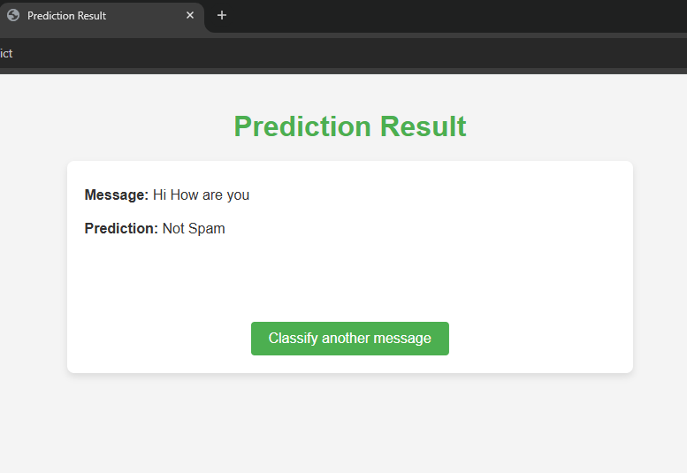
5. DEPLOYMENT & RESULTS
5.6 RESULTS: TESTING, VALIDATION & FINAL RESULTS
Output:
Sample Predictions: Screenshots or examples of input messages with their respective classification outputs.
Spam Message Identification Not Spam Message Identification

Slide 16
6. CONCLUSION
6.1 PROJECT CONCLUSION
The Spam Detection System developed in this project demonstrates the potential of machine learning and Natural Language Processing (NLP) in effectively filtering spam messages. By leveraging Support Vector Machine (SVM) classification and TF-IDF vectorization, this model can reliably classify text messages as spam or non-spam with high accuracy. This system addresses the problem of unwanted spam communications, providing a scalable solution that can be easily integrated into applications and services, reducing user exposure to irrelevant and potentially harmful content. The deployed web application allows end-users to conveniently test message inputs, offering real-time spam classification.
6.2 FUTURE SCOPE
This project provides a foundation for further enhancements, such as:
Expanding the dataset to improve accuracy across diverse spam formats and languages.
Incorporating deep learning models, such as recurrent neural networks (RNN) or transformers, for improved performance with larger datasets.
Developing an adaptive model that evolves with changing spam patterns, using online learning methods.
Enhancing the application interface and deploying it as a service for broader use, potentially integrating with email or messaging platforms for real-time spam filtering.

Slide 17
REFERENCES
[1] Cohen, J. (2009). Natural Language Processing with Python: Analyzing Text with the Natural Language Toolkit. O'Reilly Media. Available at: https://www.oreilly.com/library/view/natural-language-processing/9780596803346/
[2] Raschka, S. (2019). Python Machine Learning: Machine Learning and Deep Learning with Python, scikit-learn, and TensorFlow 2. Packt Publishing. pp. 219-243. Available at: https://www.packtpub.com
[3] NLTK Documentation. Natural Language Toolkit. Available at: https://www.nltk.org/
[4] Scikit-learn Documentation. scikit-learn: Machine Learning in Python. Available at: https://scikit-learn.org/
[5] Flask Documentation. Flask Web Development. Available at: https://flask.palletsprojects.com/

